Slide 1
IBM Data Science Capstone Project
PRIME LOCATION TO OPEN RESTAURANT
Tushar Kawadkar

Slide 2
PROBLEM
This aim of the project is to help facilitate the process of choosing a location and opening a restaurant for a business owner.
For this project we’ll try to find out the best location/ areas to open an Indian restaurant in the city of Toronto.
The success of the restaurant will be determined by the location and the area where it is opened.
The financial gain of the restaurant will be decreased if the there are too many Indian restaurants in the local vicinity.
Additionally, starting a restaurant in a location with higher income would increase the profitability of the business over starting in a poorer area.

Slide 3
DATA
To find the solution for the proposed business problem, we’ll have to collect data from various sources:
Population & Ethnic Distribution of Each Neighborhood (Toronto Census)
Income Distribution of Each Neighborhood (Toronto Census)
Number of Restaurants in Each Neighborhood (Foursquare API)
Number of Indian Restaurants in Each Neighborhood (Foursquare API)

Slide 4
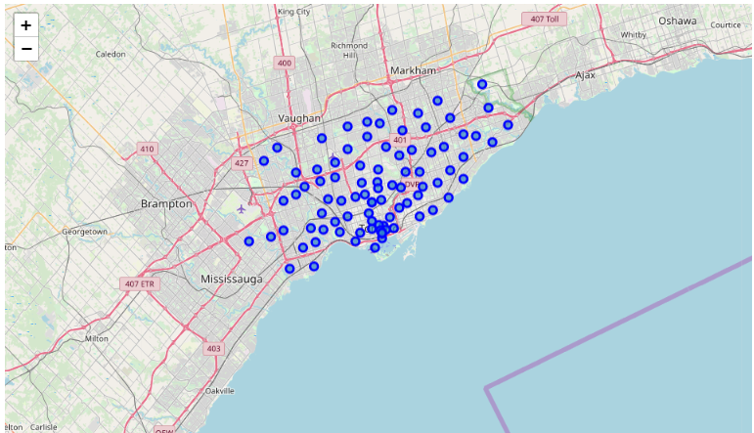
Plotted Neighborhoods from the dataset

Slide 5
APPLYING k-means CLUSTERING for k = 5

Slide 6
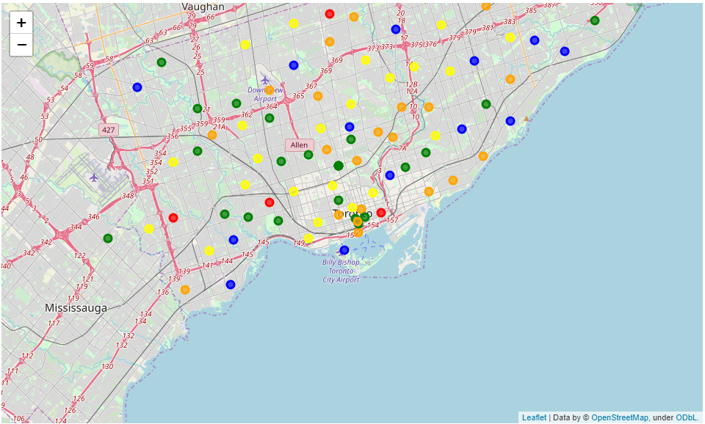
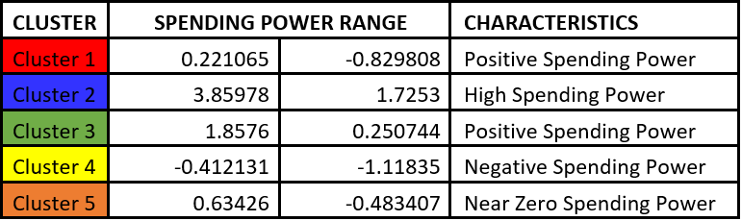

Slide 7
RECOMMENDED LOCATIONS

Slide 8
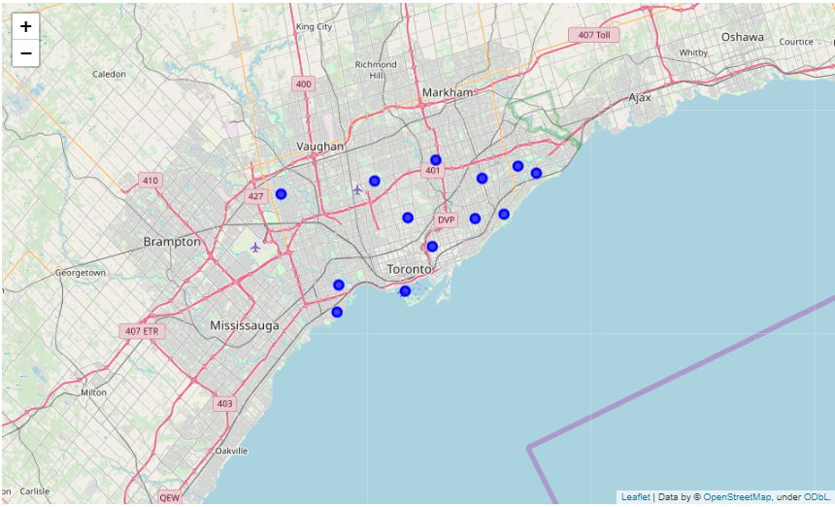

Slide 9
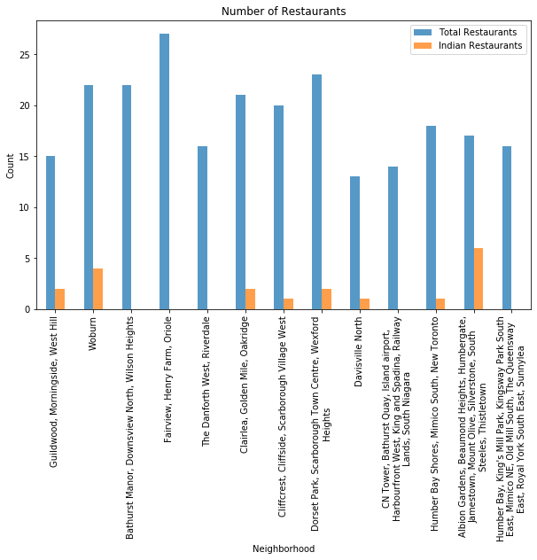

Slide 10
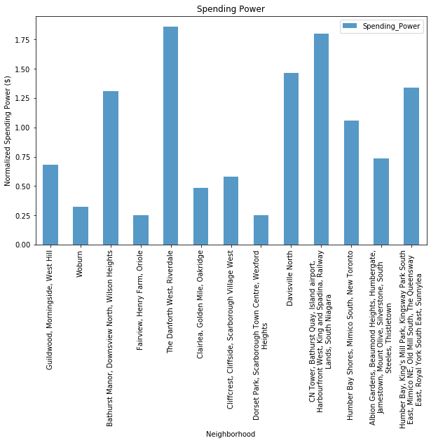

Slide 11
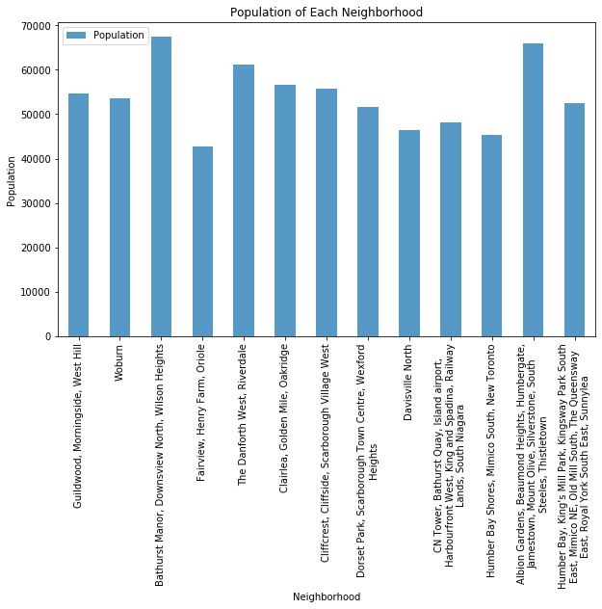

Slide 12
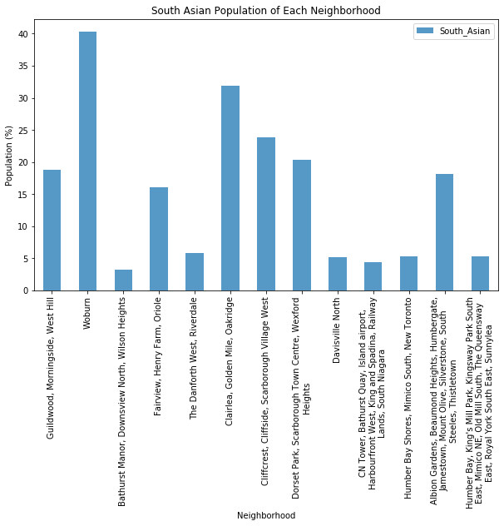

Slide 13
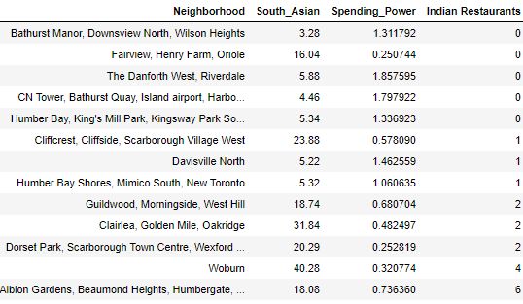
CONCLUSION
From the results of the clustering algorithm, it was determined that neighborhoods corresponding to cluster 3 were the best choice for opening an Indian restaurant based on the normalized spending power and population.

